Slide 1


Azure Document Intelligence
Author: Phat.Tran
01/2025

Slide 2


TABLE OF CONTENTS
01.
04.
06.
What is Azure Document Intelligence?
Intergrate with .Net Core
<<Content item 6>>
02.
05.
07.
Model types
Pricing
<<Content item 7>>
03.
Train a custom model

Slide 3


What is Azure Document Intelligence?

Slide 4

What is Azure Document Intelligence?
Azure AI Document Intelligence is a cloud-based service by Azure AI that enables you to develop intelligent document processing solutions. By handling large volumes of data from various types of forms and documents, this service helps efficiently manage the speed at which information is collected and processed. It plays a crucial role in enhancing operational efficiency, making accurate data-driven decisions, and driving innovative advancements

Slide 5
Model types

Slide 6

Model types
Azure Document Intelligence offers 3 model types for data extraction from input documents:
Document Analysis: Extracts text, tables, structures, key-value pairs, and named entities from various documents.
Prebuilt Models: Specialized models for specific document types like invoices, ID documents, and more.
Custom Models: Allows training tailored models to classify documents and extract text, structure, or specific fields from forms or custom documents.

Slide 7
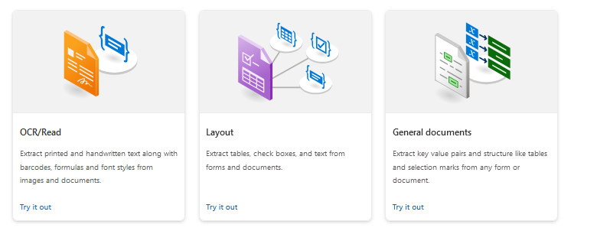
Model types
Document analysis

Slide 8
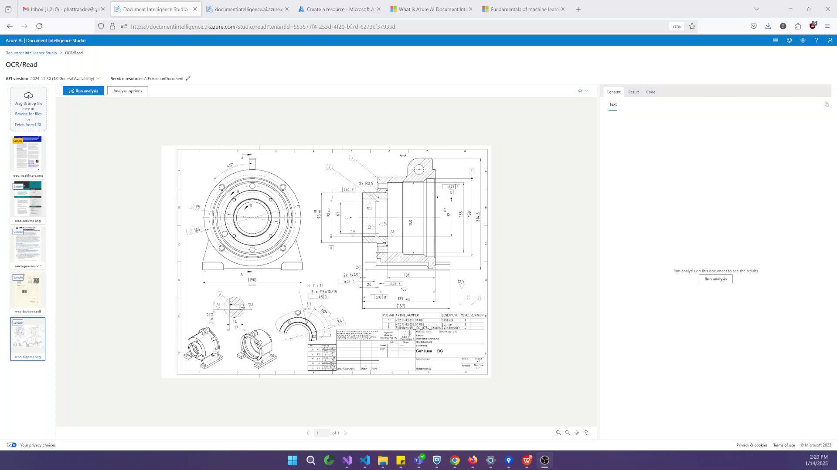
Model types
OCR/Read (Extract text from printed & handwritten)

Slide 9
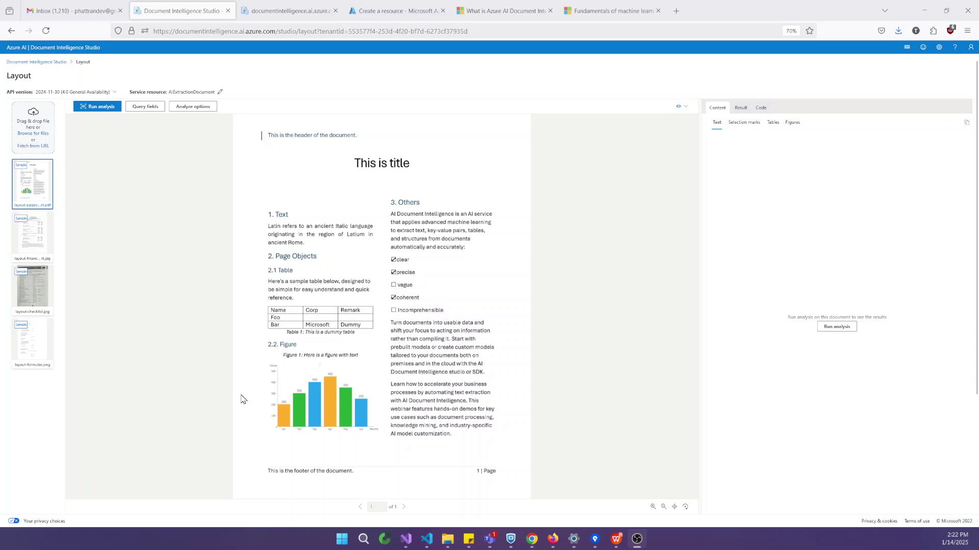
Model types
Layout (Extract data in form tables, check boxes & text))

Slide 10
Model types
General documents (Similar to the Layout model but also extracts key-value pairs along with text and structure.)

Slide 11
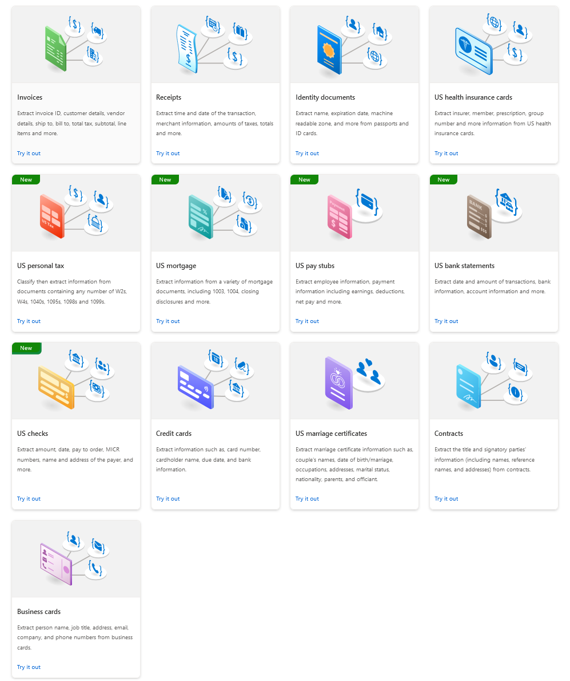
Model types
Prebuilt models
Extract data from unique document types using the following prebuilt models

Slide 12
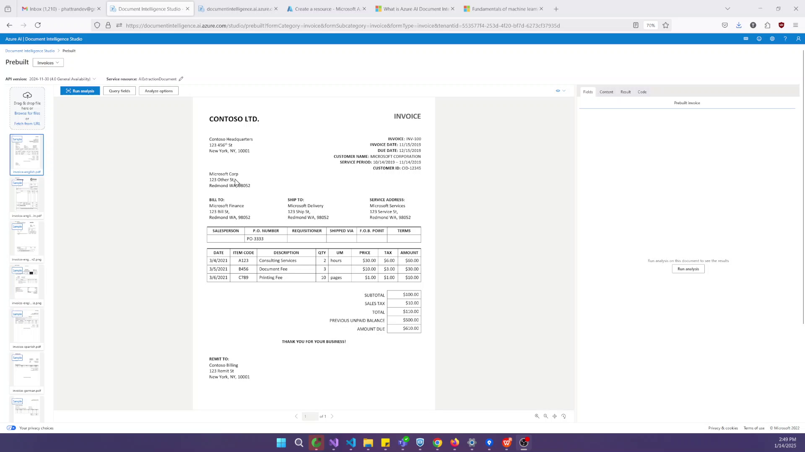
Model types
Prebuilt models

Slide 13
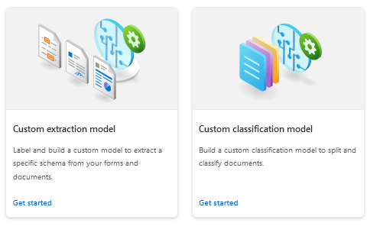
Model types
Custom models

Slide 14
Train a custom model

Slide 15
Train a custom model

Slide 16
Q & A

Slide 17

THANK YOU!

